Slide 1
King County House sales Prediction
Made by Mirolim Saidakhmatov

Slide 2
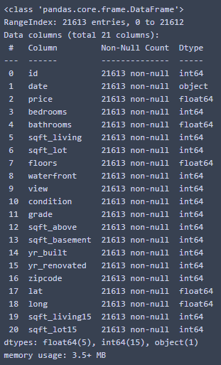
The Dataset
The dataset was taken from: https://www.kaggle.com/harlfoxem/housesalesprediction
It consists of data about house sales in King County.
The dataset is consisted of 21613 rows with 21 columns.
It has no null values.
It has right-skewed distribution for target column named ‘price’.

Slide 3
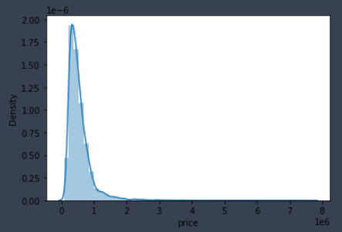
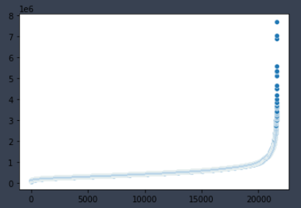
Explanatory Data analysis
As we said, the distribution of price column And the scatter plot of the target

Slide 4
Preprocessing
We realized that “id” and “date” columns we will not use as they do not contain any specific information and so dropped them.
After, we splitted our dataset into train and test set.
Then by running double loop, we train and tested our models by choosing scalers, models, PCA.
We tested two scalers: Standard Scaler and Min Max Scaler.
We had three models to compare: Linear Regression, Ridge, Lasso.
And tried PCA to select best features.
We had not done any feature engineering techniques as the dataset was ready to work with, i. e. all columns were converted to numeric values.

Slide 5
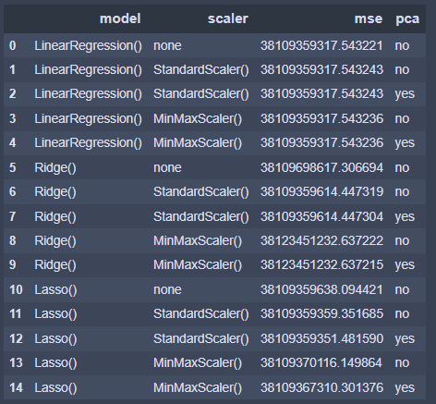
Comparing results
After all, we stores results in one data frame and
sorted for convenience.
As we see, the best performance was showed by
simple Linear Regression with no scaler and no PCA,
which gave us the least mean squared error.

Slide 6
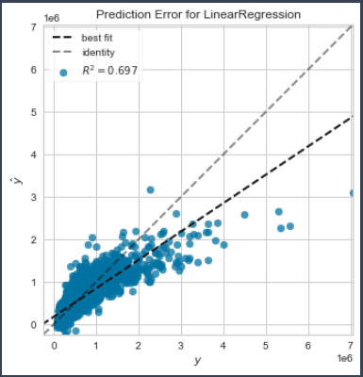
Results Visualization
In the final part, we have plot showing error, i. e. R^2 difference between pure data for testing and predicted data for that testing set.
The “identity”s broken line shows the original data, whereas best fit is showing the performance of the predicted values.

Slide 7
Conclusion
In the end, we have built a model to predict house prices.
We have tried 3 models, with Principal Components Analysis technique for feature selection.
The best performance was obtained by pure Linear Regression without any scalings and PCA.
For more details you can run IPython notebook named “test_task.ipynb”.
Thank you for your attention.

